Slide 1
Welcome! Please get out your prelab for a stamp!
Please pass forward your tag and recapture activity from last class!

Slide 2
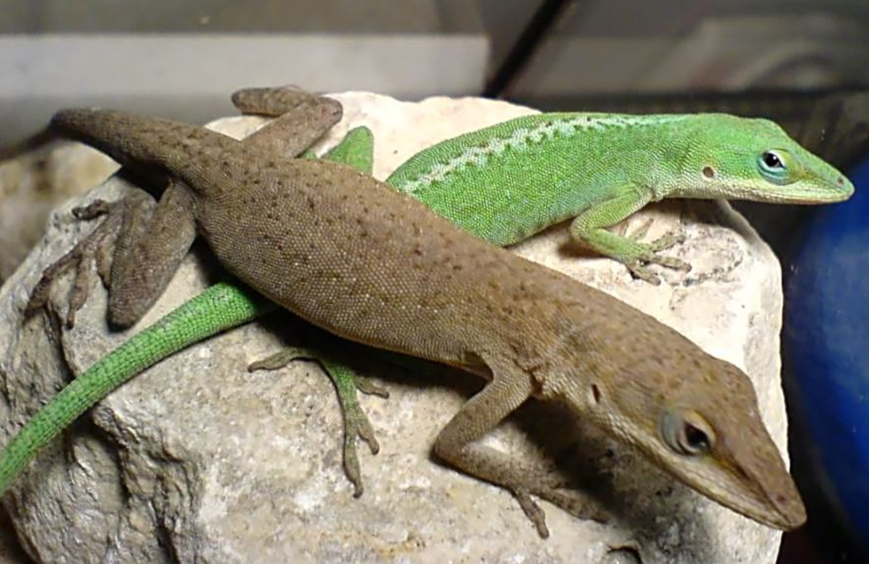
Today’s purpose: How many Green Anoles live in Wolf Prairie?
^{7nd} period tags
2th and 6th periods recapture

Slide 5
Tagging
Catching them – need to be quiet
Look carefully – “Zen out” camouflage, up on branches
Laser strategy
Be gentle!
Tag with sharpie – mark behind head on neck, dark band all around and a number
Photograph tagged anole
Release to same location

Slide 7
Roles:
Catching pairs – net, gloves, sharpies (10)
Pairs stay in location
Others – at seating area, joining iNaturalist

Slide 8
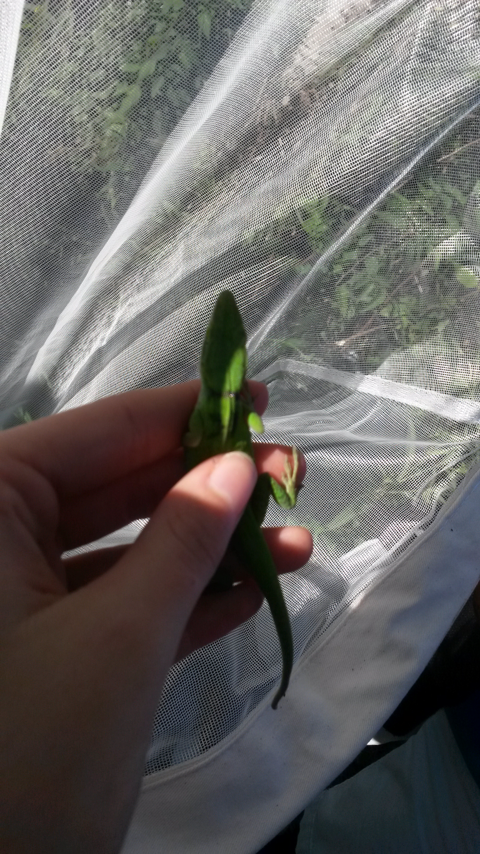

Slide 9
Catching folks:
Pair up on our walk out there!

Slide 10
Recapture:
Photography! Try to get their backs to find the tag number!

Slide 11
Pairs put in ONE location!
Work together to look carefully for the anoles.
Get a picture of each DIFFERENT anole you see.
Look at its neck for the sharpie marks – that’s a TAGGED anole.

Slide 12
Find your lab sheet:
Lab: Determining the population of Green Anoles (Anolis carolinensis) in Wolf Prairie
Discuss with your neighbor, then fill in the Hypothesis.
How did you come up with that number?

Slide 13
Let’s crunch the numbers!
Estimated population = ave total recaptured
Actual number tagged ave recaptured with tag

Slide 14
Critique this study!
How accurate do you think the estimated population is?
What could be done differently to ensure better accuracy?
What were our design flaws?

