Slide 1
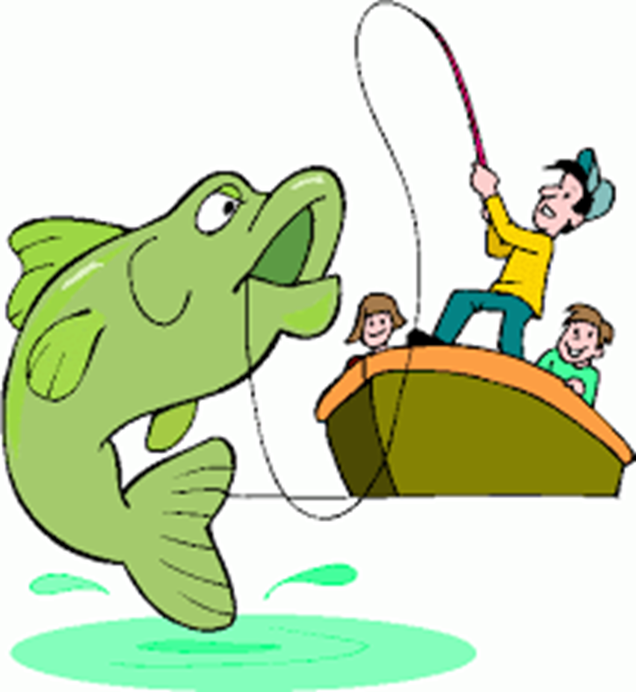
Welcome!
Please read the board!

Slide 2
Today we’re “going fishing”!

Slide 3
Each team will need:
1 blue box with beans
4 sets of directions
1 Fish Data Table

Slide 4
Reading directions: Create a strategy to maximize your profits!

Slide 5
Let’s fish!

Slide 6
Please return all materials

Slide 7
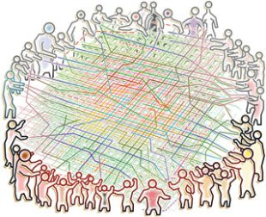
Tragedy of the Commons
The ruin of commonly shared resources when individuals use more than their fair share.

Slide 8
Which are commonly shared resources?
Cows on a family ranch
The atmosphere
Fish in the ocean
Galveston Bay
Your bedroom
Ms. Klein’s house
The Westside Commons
A farmer’s land

Slide 9
Tragedy of the Commons
Harm to shared resources because of individual actions

Slide 10
Tragedy of the Commons Success of the Commons
Protection and help for
Harm to shared resources because of individual actions

Slide 11
Litter
Trash on the street

Slide 12
Pesticide
Toxin used to kill animals or plants

Slide 13
Biomagnification
Accumulation of toxin as it moves up the food chain

Slide 14
Tragedy of the Commons
The ruin of commonly shared resources when individuals use more than their fair share.
When no one owns a resource, it is more likely to be hurt.
Examples of commonly shared resources:

Slide 15
Litter in Galveston Bay is an example of the Tragedy of the Commons.
We can stop the Tragedy: Each of us helps or harms the Bay a little bit. It adds up!

