Slide 1
Welcome!
Guess which way the water is going!
How do you know?

Slide 2
Watershed models
Why does it move that way?
Model – where will the water go?

Slide 3
uphill
downhill

Slide 4
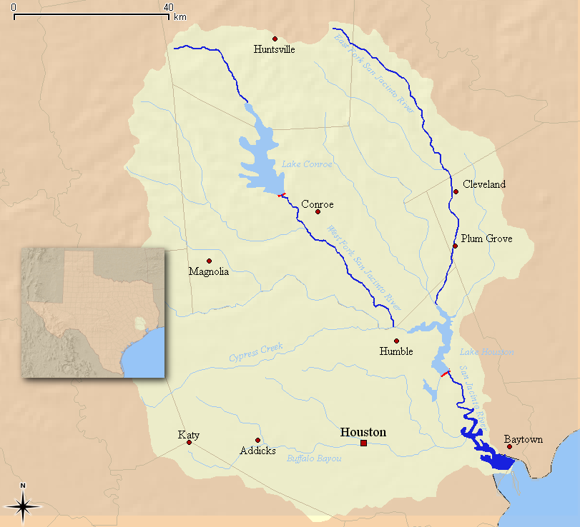
Watershed – rain goes from upstream to downstream

Slide 5
Watershed – LAND: WHEN IT RAINS HERE, WATER GOES INTO THE RIVER/BAYOU

Slide 6
Upstream – where the water comes from (uphill)
Downstream – where the water goes to (downhill)
Notes:
Tributaries classified from the mouth of a water body back upstream

Slide 7
Watershed boundary – change in elevation around the outside of a watershed
Notes:
Tributaries classified from the mouth of a water body back upstream

Slide 8
River source – beginning of a stream/river/bayou
Notes:
Tributaries classified from the mouth of a water body back upstream

Slide 9
River mouth – where stream/river/bayou goes into a bigger body of water
Notes:
Tributaries classified from the mouth of a water body back upstream

Slide 10
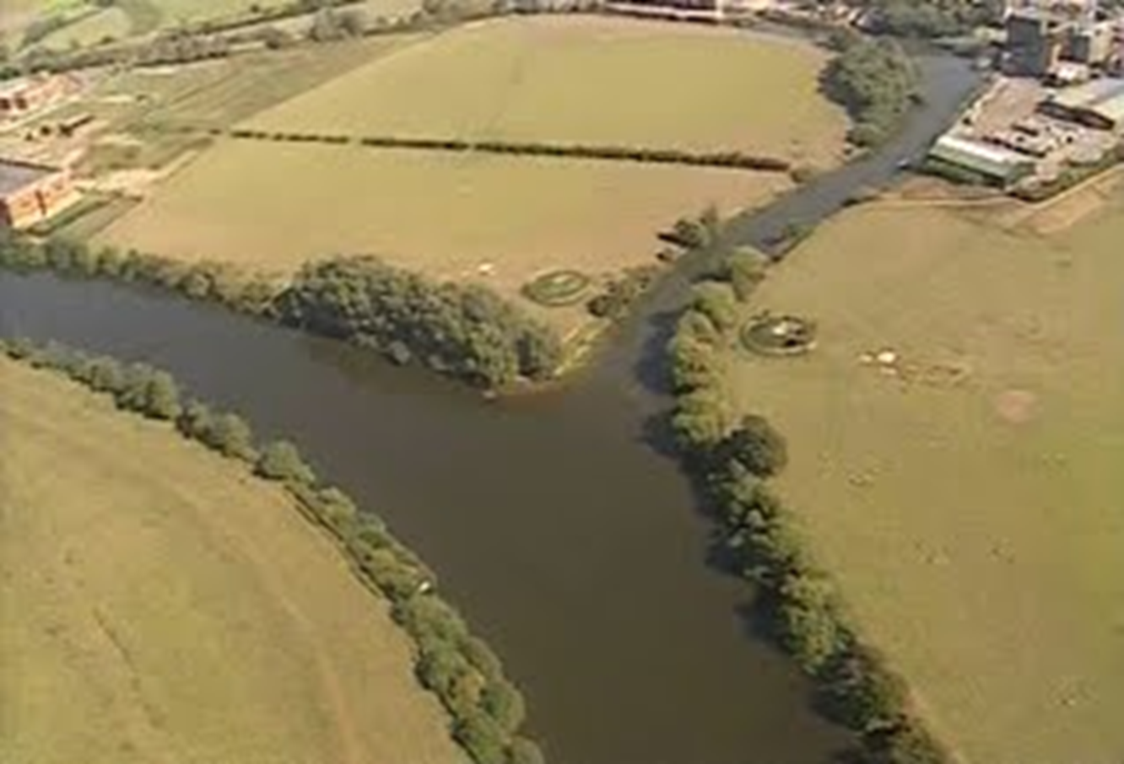
Tributary – smaller stream that goes into a larger stream
Notes:
Tributaries classified from the mouth of a water body back upstream

Slide 11
Confluence – where two tributaries/rivers meet
Notes:
Tributaries classified from the mouth of a water body back upstream

Slide 12
Confluence of tributaries

Slide 13
Confluence of tributaries

Slide 14
Source

Slide 15
Three tricks:
Big body of water (ocean/bay) is the mouth
Confluence of tributaries makes arrow pointing downstream
“dead ends” are the sources

Slide 16
Now let’s try this with maps! Paste labels to board

Slide 17
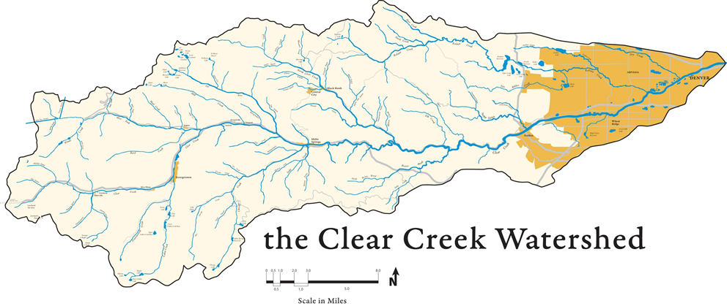

Slide 23
Use the marker to label these
Watershed boundary
Upstream
Downstream
River mouth
River source
Confluence
tributary

