Slide 1
Prairie Poker
Where has all the prairie gone?

Slide 2
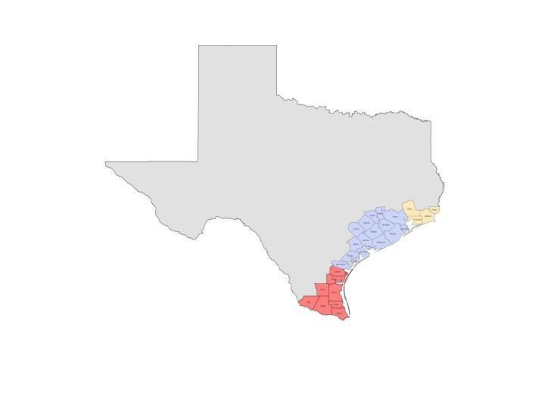
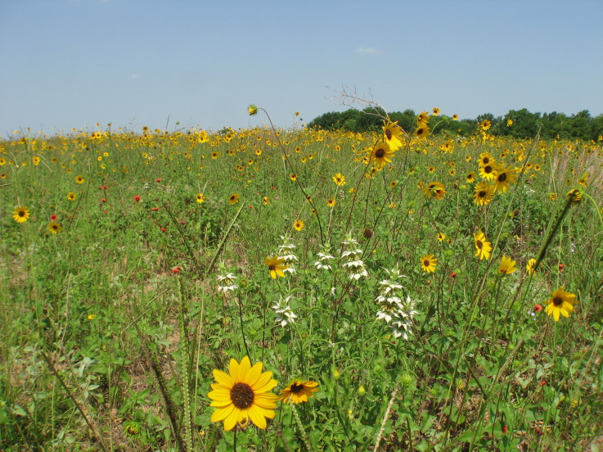
200 years ago, the Gulf Coastal Prairie covered 6.5 million acres in Texas + 2.5 million acres in Louisiana

Slide 3
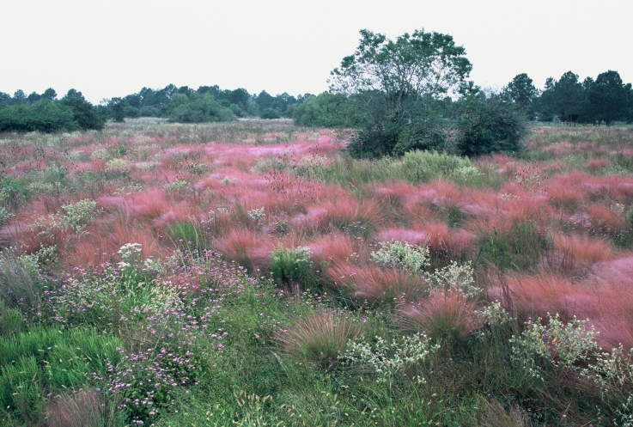
100 cards = 100% of the original Gulf Coastal Prairie

Slide 4
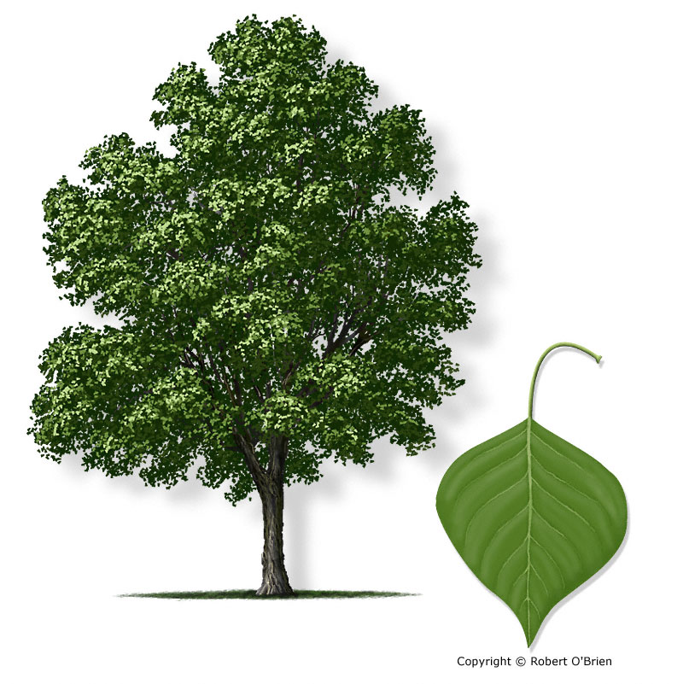
2,3,4’s – area which has been covered with invasives
Chinese Tallow

Slide 5
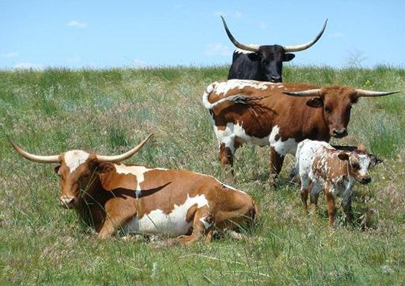
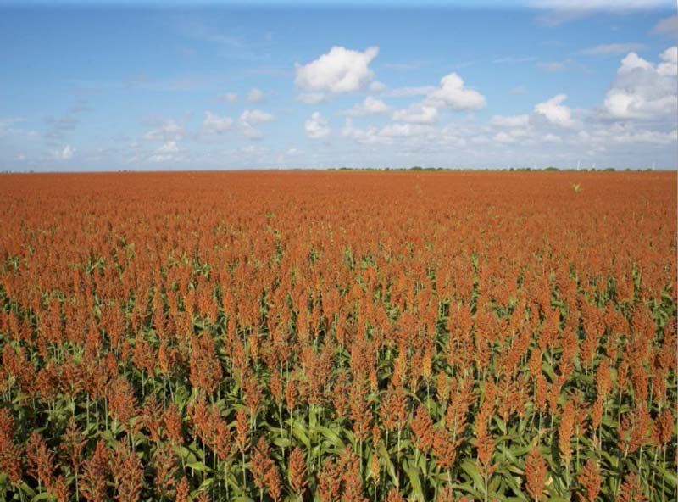
5,6,7,8,9,10, Jacks, Queens – converted to ranching, farming

Slide 6
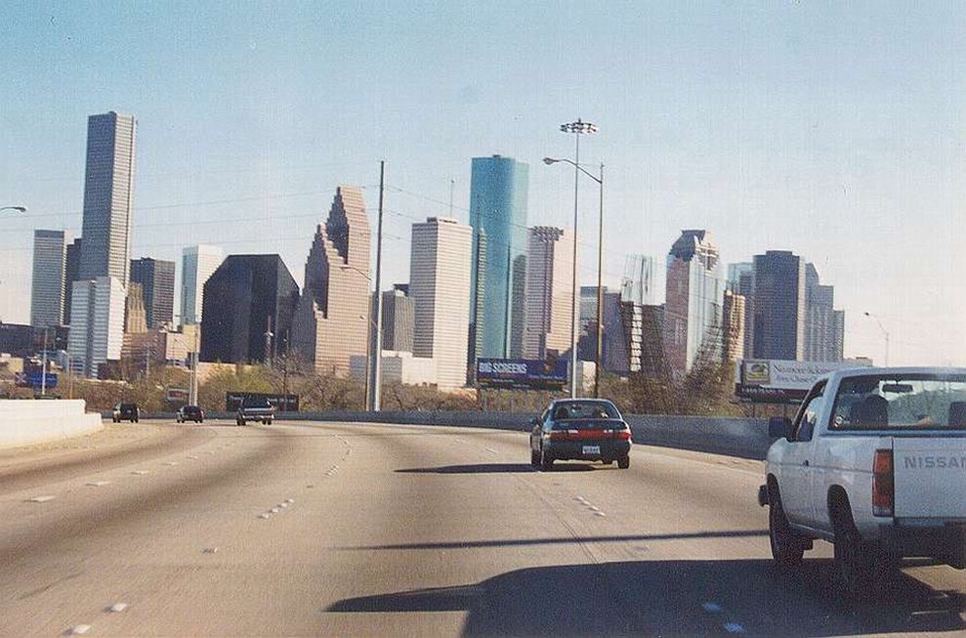
Kings & A hearts – prairie covered by cities

Slide 7
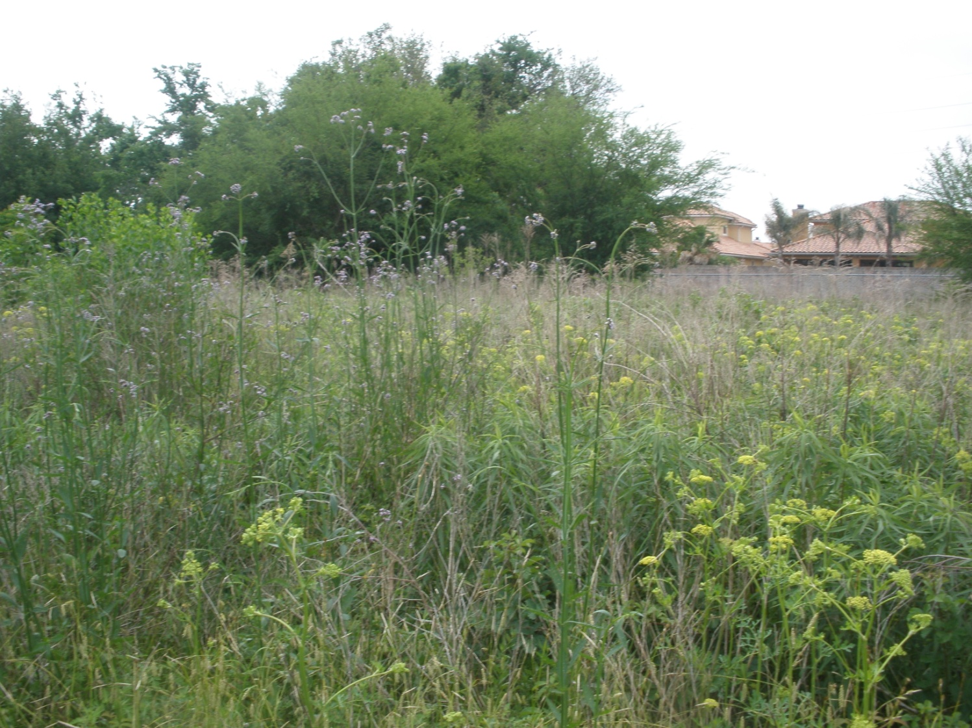
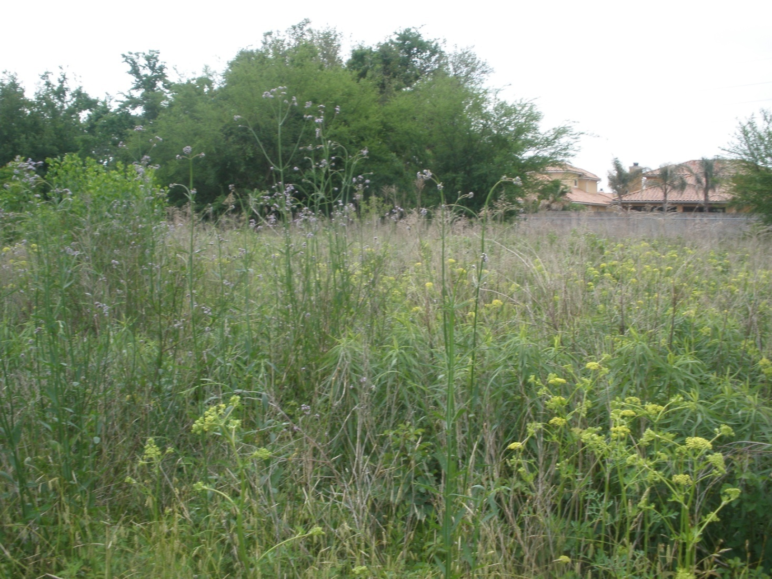
A clubs and diamonds – prairie that’s still there but degraded.

Slide 8
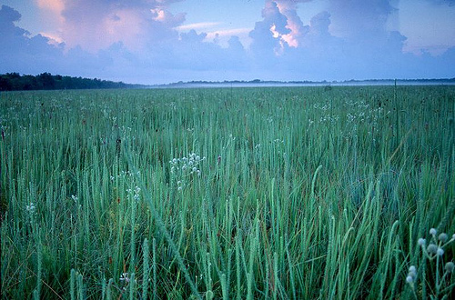
A Spades – the ink in the middle is what’s left in pristine condition!

Slide 9
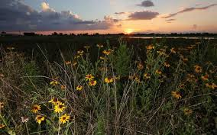
Less than 1% of our original Gulf Coastal Prairie remains!

